Slide 1
GEOG0125
Advanced Topics in Social and Geographic Data Science
Introduction to BAYESIAN Generalised linear models (GLM)
Dr Anwar Musah (a.musah@ucl.ac.uk)
Lecturer in Social and Geographic Data Science
UCL Geography
1

Slide 2
Contents
Problem
Knowledge
Collect
What are Generalised Linear Models (GLMs)?
Link functions
Selecting the appropriate type of statistical model
Linear regression model
Logistic regression model for Bernoulli OR Binomial
Poisson-based regression models (Normal, Negative Binomial & Zero-Inflated)
What does each statistical model do?
Linear relationships
Log-odds and Odd Ratios (ORs)
Relative risk ratios (RRs)
Interpretation of coefficients
Model Specification from a Bayesian Framework
Model
Wrangle
Explore
2

Slide 3
Remember in Term 1… In Week 9’s PSA lecture, we said…
3

Slide 4
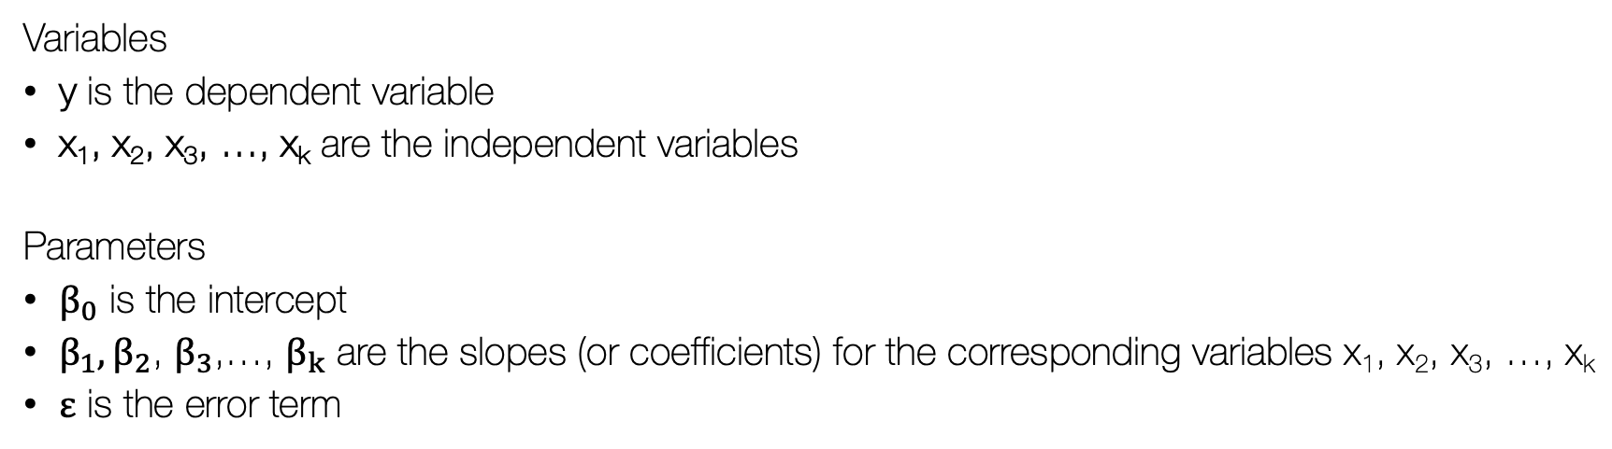
Multivariable Linear Regression Model
$$y= β_{0}+β_{1}x_{1}+β_{2}x_{2}+…+ε$$
Notes 1: Remember, in term 1 (week 9), we described what a linear regression model was before discussing at length what spatial lag and error models were etc.
Variables
y is the dependent variable
x₁, x₂, x₃, …, x_{k} are the independent variables
Parameters
$β_{0}$ is the intercept
$β_{1},β_{2}$, $β_{3}$,…, $β_{k}$ are the slopes (or coefficients) for the corresponding variables x₁, x₂, x₃, …, x_{k}
$ε$ is the error term
Notes 2: We mentioned that a linear regression model such as the above formula allows the user to quantify the relationship (or association) between a continuous outcome (i.e. dependent variable) with one, or more predictors (i.e., independent variable(s)). These models are good for making causal and predictive inference
4

Slide 5
In terms of regression, there are several types of models, each with there own families depending on the type distribution for the dependent variable:
Here is a board overview:
Notes 1: Recall that we described how linear regression models are best suited for modelling outcomes that are only continuous measures, whereby we assumed that such continuous measures are from a Gaussian/normal distribution. Before, deep diving into spatial lag and error regression models… because are from the family of linear models but a spatial component to it.
Distribution of dependent variable | Suitable Model
Continuous measures: e.g., average income in postcode (£); concentrations of ambient particular matter (PM2.5); Normalised Vegetative Difference Index (NDVI) etc., | Linear regression
Binary measures (1 = “present” or 0 = “absent”): e.g., Person’s voting for a candidate, Lung cancer risk, house infested with rodents etc., | Logistic Regression
Binomial measure (or proportion): e.g., prevalence of houses in a postcode infested with rodents, percentage of people in a village infected with intestinal parasitic worms, prevalence of household on a street segment victimised by crime etc., | Logistic Regression
Counts or discrete measures: e.g., number of reported burglaries on a street segment, number of riots in a county etc., | Poisson Regression
Time-to-event binary measures: e.g., Lung cancer risk due to chronic exposure to environmental levels of indoor radon. Risk of landslide and time dependence of surface erosion etc., | Survival Analysis with Cox regression
5

Slide 6
In terms of regression, there are several types of models, each with there own families depending on the type distribution for the dependent variable:
Here is a board overview:
Notes 1: Recall that we only touched on outcomes that can follow a different distribution, and models can potentially be violated if the inappropriate outcome is fitted into the wrong model!
Distribution of dependent variable | Suitable Model
Continuous measures: e.g., average income in postcode (£); concentrations of ambient particular matter (PM2.5); Normalised Vegetative Difference Index (NDVI) etc., | Linear regression
Binary measures (1 = “present” or 0 = “absent”): e.g., Person’s voting for a candidate, Lung cancer risk, house infested with rodents etc., | Logistic Regression
Binomial measure (or proportion): e.g., prevalence of houses in a postcode infested with rodents, percentage of people in a village infected with intestinal parasitic worms, prevalence of household on a street segment victimised by crime etc., | Logistic Regression
Counts or discrete measures: e.g., number of reported burglaries on a street segment, number of riots in a county etc., | Poisson Regression
Time-to-event binary measures: e.g., Lung cancer risk due to chronic exposure to environmental levels of indoor radon. Risk of landslide and time dependence of surface erosion etc., | Survival Analysis with Cox regression
6
Notes:
…particularly for binary and discrete measures, and so this is where generalized linear regression modelling comes to play. [Turn to next slide]

Slide 7
What are Generalised Linear Models (GLMs)?
7

Slide 8
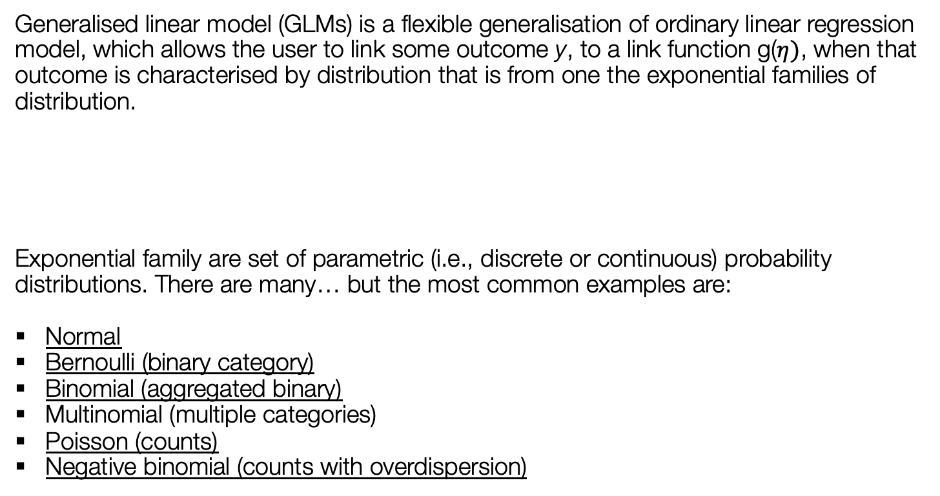
Definition:
Generalised linear model (GLMs) is a flexible generalisation of ordinary linear regression model, which allows the user to link some outcome y, to a link function g($η)$, when that outcome is characterised by distribution that is from one the exponential families of distribution.
Exponential family are set of parametric (i.e., discrete or continuous) probability distributions. There are many… but the most common examples are:
Normal
Bernoulli (binary category)
Binomial (aggregated binary)
Multinomial (multiple categories)
Poisson (counts)
Negative binomial (counts with overdispersion)
$$g(η)= β_{0}+β_{1}x_{1}+β_{2}x_{2}+…+ε$$
8

Slide 9

What is a link function $g\left(η\right)$? [1]
$$y= β_{0}+β_{1}x_{1}+β_{2}x_{2}+…+ε$$
By default, the linear regression model does not support any other outcome whose distribution is not from a Gaussian/Normal distribution.
However, by using some link function, it allows the user to transform such outcome (i.e., that’s considered binary, polychotomous, discrete etc.,) in something that behave like a linear function
The type of link function implemented on a model depends on the type of analysis you are going to perform
Notes 1: Tricking the model to thinking it is linear
$$g(η)= β_{0}+β_{1}x_{1}+β_{2}x_{2}+…+ε$$
9

Slide 10

What is a link function $g\left(η\right)$? [2]
Here are the most frequent examples which you will certainly encounter
Distribution of dependent variable | Exponential Family (Distribution) | Link Function | Suitable Model
Continuous measures | Normal distribution | Identity (we’ve been using this all this while) | Linear regression
Binary measures (1 = “present” or 0 = “absent”) | Bernoulli distribution | Logit (log-odds) | Logistic Regression
Binomial measure (or proportion) | Binomial distribution | Logit function on aggregated outcome for successful and failures (log-odds) | Logistic Regression
Counts or discrete measures | Poisson distribution | Log() or ln() | Poisson Regression
10

Slide 11
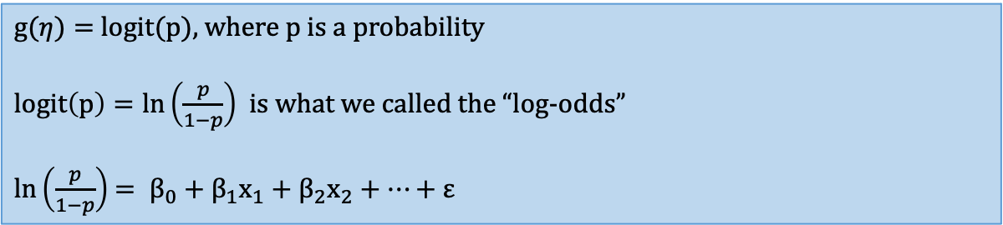
Logistic Regression [1]
This model allows the user to model binary outcomes linearly with other independent variables
Examples of such outcomes can be from Bernoulli distribution e.g., disease status: no disease = 0 or disease = 1; Victimisation status: not burgled = 0 or burgled = 1; etc.,
Other examples can also be from a Binomial distribution where binary responses are aggregated: e.g. total number of individual surveyed in a village (N) and number people detected to be positive (n)
Link function:
Notes 1: With binary outcomes, we are dealing with probabilities and not averages
$g(η)=$ logit(p), where p is a probability
$logit\left(p\right)=ln\left(\frac{p}{1−p}\right)$ is what we called the “log-odds”
$ln\left(\frac{p}{1−p}\right)$ $= β_{0}+β_{1}x_{1}+β_{2}x_{2}+…+ε$
11

Slide 12
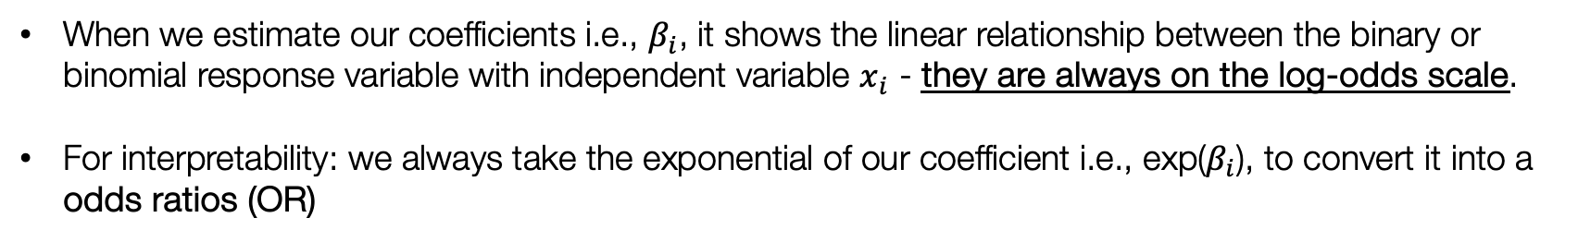
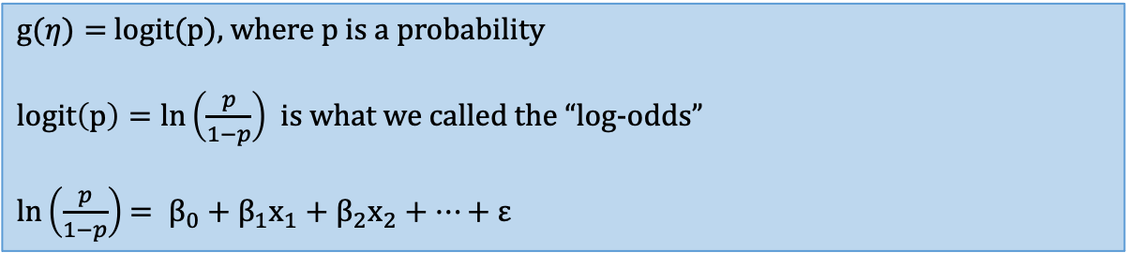
Logistic Regression [2]
$g(η)=$ logit(p), where p is a probability
$logit\left(p\right)=ln\left(\frac{p}{1−p}\right)$ is what we called the “log-odds”
$ln\left(\frac{p}{1−p}\right)$ $= β_{0}+β_{1}x_{1}+β_{2}x_{2}+…+ε$
When we estimate our coefficients i.e., $β_{i}$, it shows the linear relationship between the binary or binomial response variable with independent variable $x_{i}$ - they are always on the log-odds scale.
For interpretability: we always take the exponential of our coefficient i.e., exp($β_{i}$), to convert it into a odds ratios (OR)
This is the quantity i.e., Odds Ratios (OR), we want to report and interpret from our logistic regression
12

Slide 13
Interpretation of Odds Ratios (OR)
OR = 1 (null value), it means that independent variable has no effect on the outcome
OR < 1, the independent variable has an impact on the outcome – in this case, its reduced effect, or reduced risk on the outcome
OR > 1, the independent variable has an impact on the outcome – and so, in this case, its increased effect, or increased risk on the outcome
Notes 1: In the Frequentist approach, we use p-values and 95% CIs to deem whether the odd ratios are statistically significant or not. The Bayesian framework, only 95 credibility intervals are needed for significance.
13

Slide 14
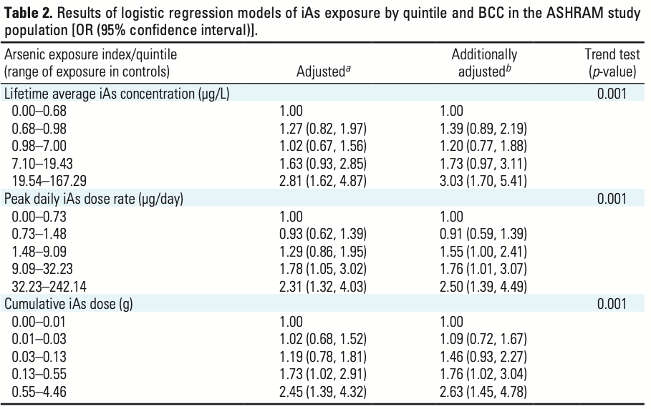
Notes 1: An example of logistic regression model, applied to health risk assessment study determining the impacts of arsenic exposure (biomarkers) and skin cancer risk in Eastern Europe.
Interpretation for independent variable that is categorical
Giovanni et al. 2012 [Source]
14

Slide 15
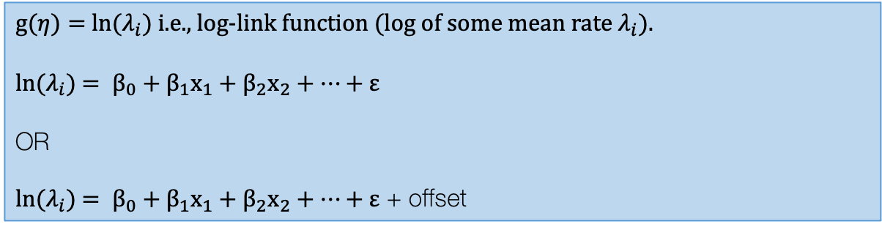
Poisson Regression [1]
This model allows the user to model count or discrete outcomes linearly with other independent variables
Examples of such outcomes can be from Poisson distribution e.g., number of COVID cases in postcodes across London; Number of houses on street segments that were victims to burglary etc.
It is use for dealing with aggregated units the contain information of counts or rates (expressed per capita)
Link function:
$g(η)=$ ln($λ_{i}$) i.e., log-link function (log of some mean rate $λ_{i}$).
ln($λ_{i}$) $= β_{0}+β_{1}x_{1}+β_{2}x_{2}+…+ε$
OR
ln($λ_{i}$) $= β_{0}+β_{1}x_{1}+β_{2}x_{2}+…+ε$ + offset
Often an offset is included to adjust for denominators if the outcome was measured as a rate.
15

Slide 16
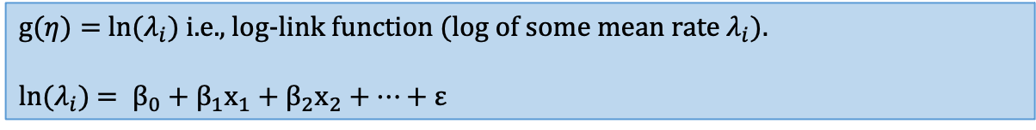
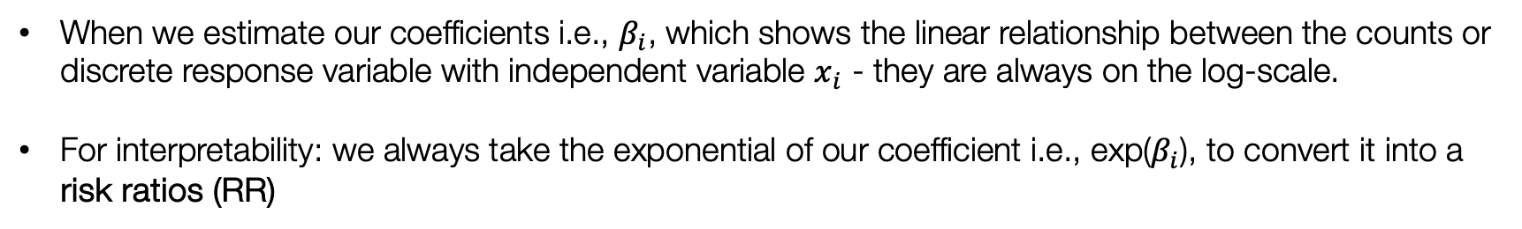
Poisson Regression [2]
$g(η)=$ ln($λ_{i}$) i.e., log-link function (log of some mean rate $λ_{i}$).
ln($λ_{i}$) $= β_{0}+β_{1}x_{1}+β_{2}x_{2}+…+ε$
When we estimate our coefficients i.e., $β_{i}$, which shows the linear relationship between the counts or discrete response variable with independent variable $x_{i}$ - they are always on the log-scale.
For interpretability: we always take the exponential of our coefficient i.e., exp($β_{i}$), to convert it into a risk ratios (RR)
This quantity i.e., Risk Ratios (RR) (interchangeable with the term Relative Risk Ratios), is the thing we want to report and interpret from our Poisson regression
16

Slide 17
Interpretation of Risk Ratios (RR)
RR= 1 (null value), it means that independent variable has no effect on the outcome
RR < 1, the independent variable has an impact on the outcome – in this case, it’s a reduced effect, or reduced risk of the outcome
RR > 1, the independent variable has an impact on the outcome – and so, in this case, it has an increased effect, or increased risk on the outcome
Notes 1: From the Frequentist approach, We use p-values and 95% CIs to deem whether the risk ratios are statistically significant or not. In the Bayesian, we don’t deal with p-values, only 95% credibility intervals
17

Slide 18
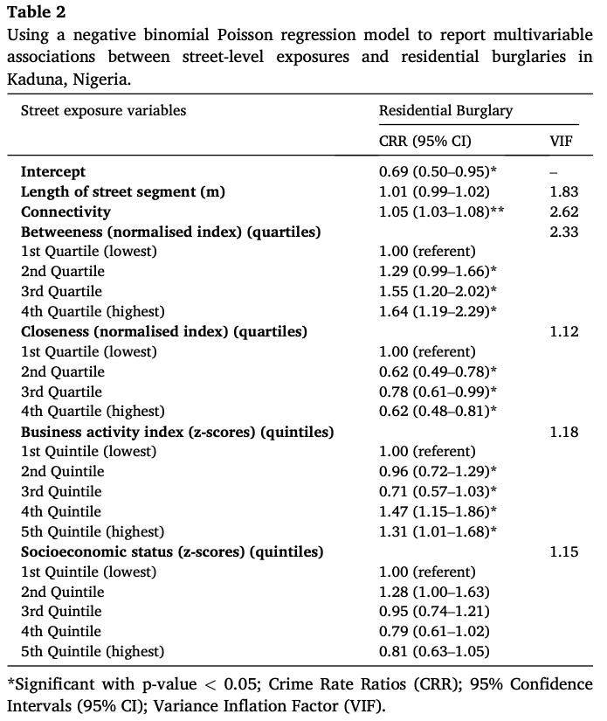
Notes 1: An example of Poisson-based regression model, applied to crime victimisation study to determine the impacts of various environmental and society society risk factor (quantified on a street-level) and burglary risk in Nigeria.
Interpretation for independent variable that are continuous as well as those that are categorical
Risk ratio which has been operationalised and termed as Crime risk ratio (CRR)
Musah et al. 2020 [Source]
18

Slide 19
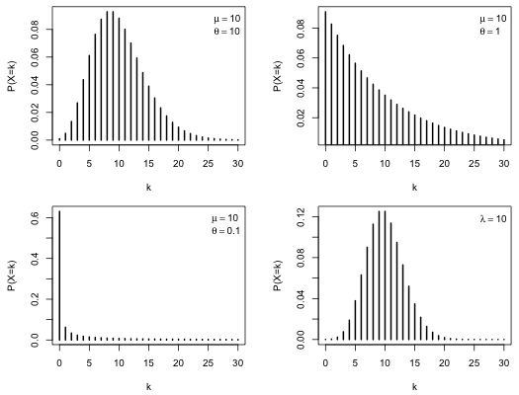
Types of Poisson Regression
Examine the frequency distribution of the count response
Scenario 1: Little to no dispersion
Use: Standard Poisson model
Scenario 2: Over dispersed
Use: Negative Binomial Poisson model
Scenario 3: Strong over-dispersed response
Use: Zero-inflated Poisson model
19

Slide 20
GLMs in a Bayesian Framework
20

Slide 21
How do you code a Bayesian GLM in RStudio?
Specifications for model block:
Logistic regression (y =1 or 0): bernoulli_logit()
Logistic regression (y = numerator & denominators): binomial_logit()
Poisson regression (y = counts or rates; normal): poisson_log()
Poisson regression (y = counts or rates; over-dispersed or zero-inflated): neg_binomial_2_log()
Let’s look at a simple linear regression case
Question:
What set of sociodemographic and water usage variables have an impact of overall water expenditure bills among Syrian refugees in stationed in camps in Jordan?
21

Slide 22
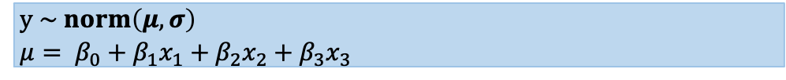
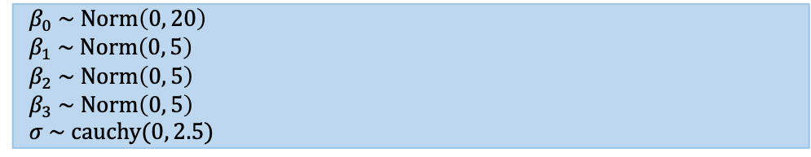
Stan code
Model formulation
data {
int<lower=0> N; // sample size N
int<lower=0> k; // number of variables 3
matrix[N, k] X; // matrix: independent variables
vector[N] y; // vector/array for outcome
}
parameters {
real beta0; // Intercept
vector[k] beta; // beta coefficients
real<lower=0> sigma; // standard deviation
}
transformed parameters {
vector[N] mu;
mu = beta0 + X*beta;
}
model {
beta0 ~ normal(0, 20); // Prior for beta0
beta ~ normal(0, 5); // Prior for beta1, 2 and 3
sigma ~ cauchy(0, 2.5); // Prior for sigma
y ~ normal(mu, sigma); // Likelihood function
}
Simple GLM (Linear case)
$$y = β_{0}+ β_{1}x_{1}+β_{2}x_{2}+β_{3}x_{3}+ε$$
Specify likelihood function. The outcome is continuous – thus it normal (so no link function is need here).
$$y \sim norm\left(μ, σ\right)$$
$$μ= β_{0}+β_{1}x_{1}+β_{2}x_{2}+β_{3}x_{3}$$
Define the priors for the intercept, coefficients and other parameters, e.g., standard deviation
$${ β}_{0} \sim Norm\left(0, 20\right)$$
$${ β}_{1} \sim Norm\left(0, 5\right)$$
$${ β}_{2} \sim Norm\left(0, 5\right)$$
$${ β}_{3} \sim Norm\left(0, 5\right)$$
$$σ \sim cauchy(0, 2.5)$$
Build Bayesian model
Recall the Bayes’ Rule: $P\left(θ | Y\right)∝P\left(Y | θ\right)P(θ)$
$$P\left({β_{0},β_{1},β_{2}, σ}_{ } | μ\right)∝P\left(μ | β_{0},β_{1},β_{2},σ\right) P\left(β_{0,}\right)P\left(β_{1}\right)P\left(β_{2}\right)P\left(β_{3}\right)P(σ)$$
22

Slide 23
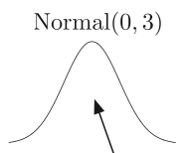
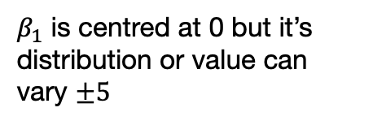
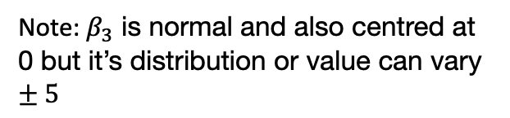
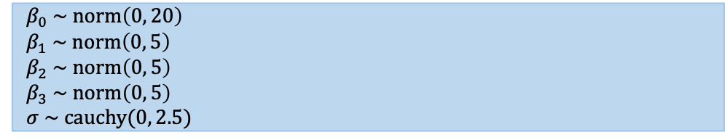


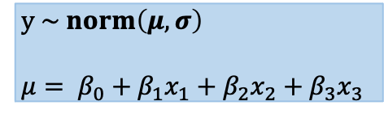
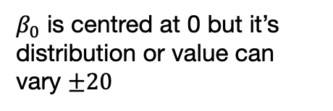
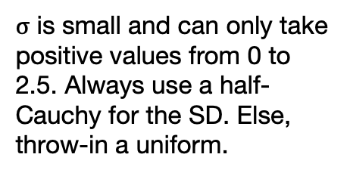

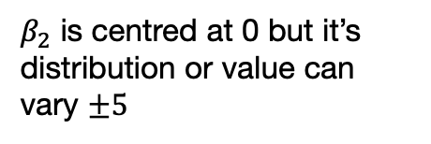

This is my model
These are my priors for the coefficients and standard deviation
$$y \sim norm\left(μ, σ\right)$$
$$μ= β_{0}+β_{1}x_{1}+β_{2}x_{2}+β_{3}x_{3}$$
$${ β}_{0} \sim norm\left(0, 20\right)$$
$${ β}_{1} \sim norm\left(0, 5\right)$$
$${ β}_{2} \sim norm\left(0, 5\right)$$
$${ β}_{3} \sim norm\left(0, 5\right)$$
$$σ \sim cauchy(0, 2.5)$$
What are we saying?
Intercept
Coefficient for variable 1
Coefficient for variable 2
Standard deviation
${ β}_{0} \sim$norm(0, 20)
${ β}_{1} \sim$norm(0, 5)
${ β}_{2} \sim$norm(0, 5)
$$σ \sim cauchy(0, 2.5)$$
-20
0
+20
-5
0
+5
-5
0
+5
+2.5
0
$β_{0}$ is centred at 0 but it’s distribution or value can vary $±20$
$β_{1}$ is centred at 0 but it’s distribution or value can vary $±5$
$β_{2}$ is centred at 0 but it’s distribution or value can vary $±5$
$σ$ is small and can only take positive values from 0 to 2.5. Always use a half-Cauchy for the SD. Else, throw-in a uniform.
Note: $β_{3}$ is normal and also centred at 0 but it’s distribution or value can vary $±5$
23

Slide 24
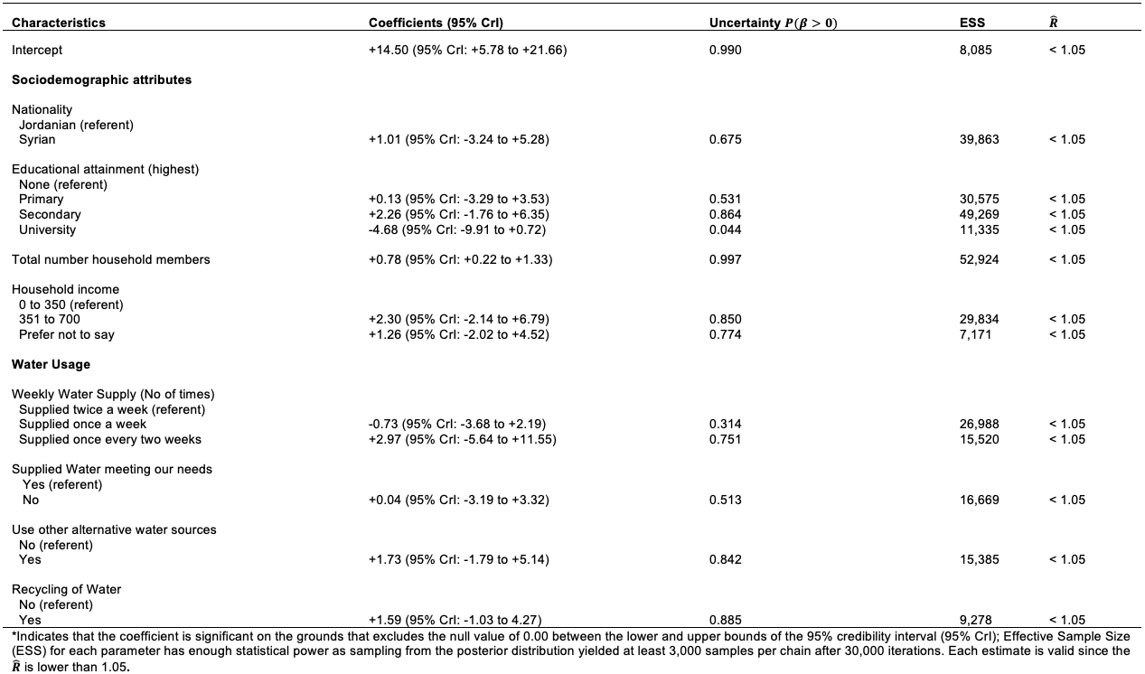
Example with exceedance probabilities
Linear model
(cat)
(cat)
(cont)
(cat)
(cat)
(cat)
(cat)
(cat)
24

Slide 25
Any questions?
25

